Slide 1
ME16A: CHAPTER THREE
BENDING MOMENTS AND SHEARING FORCES IN BEAMS

Slide 2
3.1 BEAM
A structural member which is long when compared with its lateral dimensions, subjected to transverse forces so applied as to induce bending of the member in an axial plane, is called a beam.

Slide 3
3.1.1 TYPES OF BEAMS
Beams are usually described by the manner in which they are supported.
For instance, a beam with a pin support at one end and a roller support at the other is called a simply supported beam or a simple beam ( Figure 3.1a).
A cantilever beam (Figure 3.1b) is one that is fixed at one end and is free at the other. The free end is free to translate and rotate unlike the fixed end that can do neither.

Slide 4
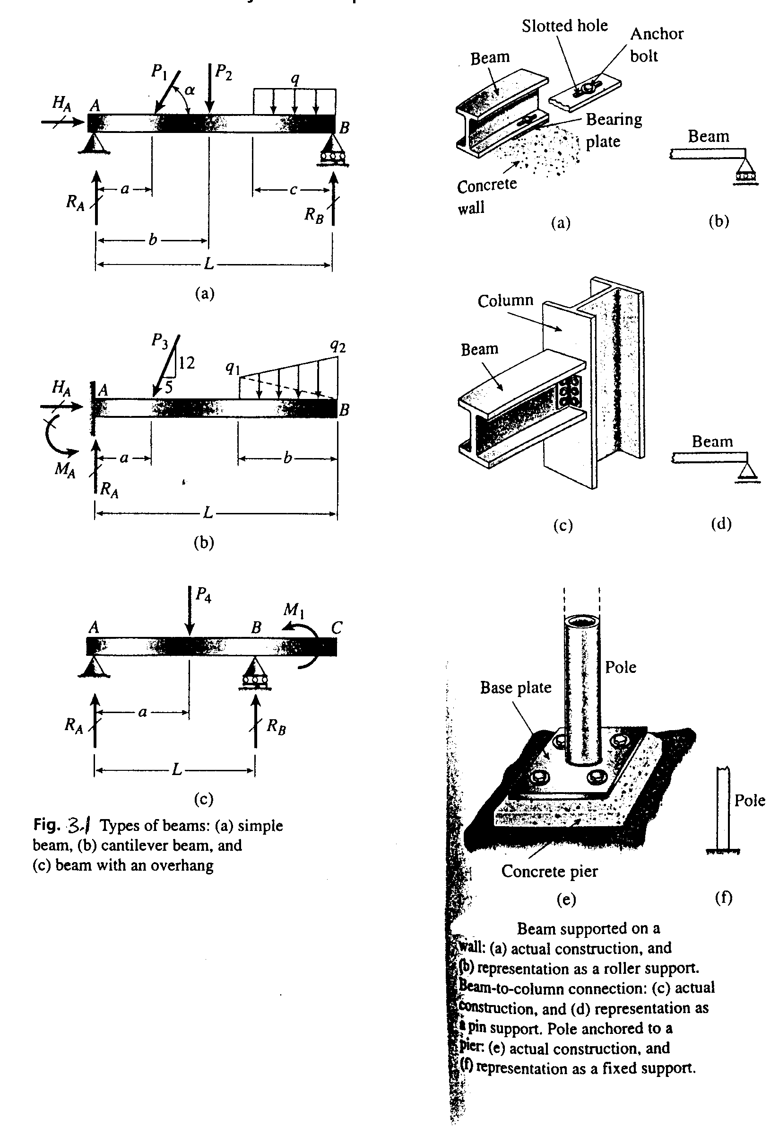
Types of Beams

Slide 5
TYPES OF BEAMS
The third example is a beam with an overhang (Figure 3.1c).
The beam is simply supported at points A and B but it also projects beyond the support at B.
The overhanging segment is similar to a cantilever beam except that the beam axis may rotate at point B.

Slide 6
3.1 TYPES OF LOADS:
A load can be classified as:
(i) Concentrated: which is regarded as acting wholly at one. Examples are loads P, P₂, P₃ and P₄ in Figure 3.1.
(ii) Distributed Load: A load that is spread along the axis of the beam, such as q in Figure 3.1 a. Distributed loads are measured by their intensity, which is expressed in force per unit distance e.g. kN/m.

Slide 7
TYPES OF LOADS CONTD.
A uniformly distributed load, or uniform load has constant intensity, q per unit distance (Figure 3.1. a).
A linearly varying load (Figure 3.1 b) has an intensity which changes with distance.
(iii) Couple: This is illustrated by the couple of moment M acting on the overhanging beam in Figure 3.1 c).

Slide 8
3.1 SHEAR FORCES AND BENDING MOMENTS
When a beam is loaded by forces or couples, stresses and strains are created throughout the interior of the beam.
To determine these stresses and strains, the internal forces and internal couples that act on the cross sections of the beam must be found.

Slide 9
SHEAR FORCES AND BENDING MOMENTS CONTD.
To find the internal quantities, consider a cantilever beam in Figure 3.2 .
Cut the beam at a cross-section mn located at a distance x from the free end and isolate the left hand part of the beam as a free body (Figure 3.2 b).
The free body is held in equilibrium by the force P and by the stresses that act over the cut cross section.

Slide 10
SHEAR FORCES AND BENDING MOMENTS CONTD.
The resultant of the stresses must be such as to maintain the equilibrium of the free body.
The resultant of the stresses acting on the cross section can be reduced to a shear force V and a bending moment M.
The stress resultants in statically determinate beams can be calculated from equations of equilibrium.

Slide 11
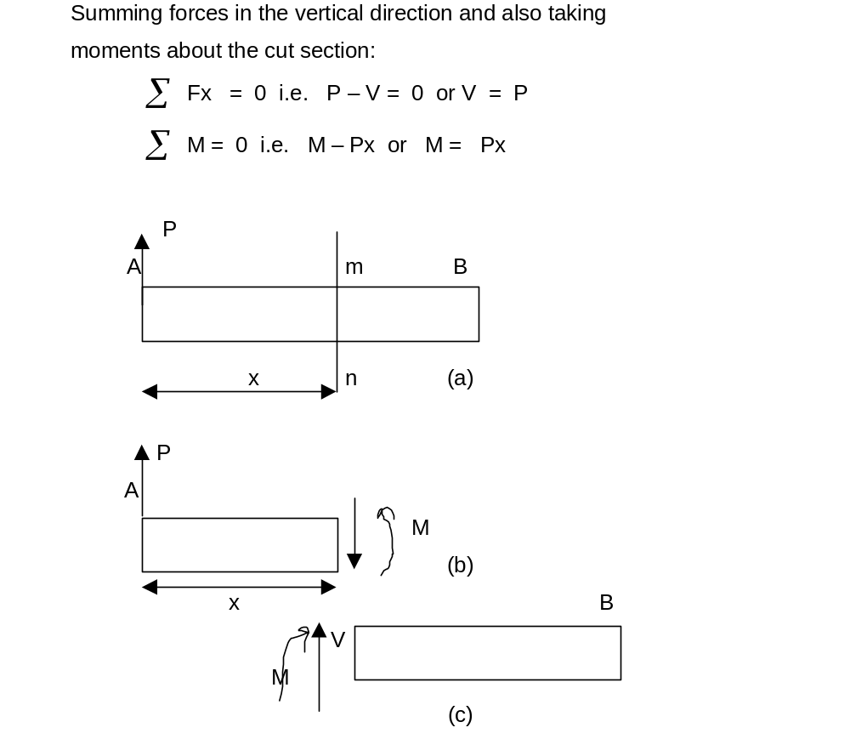
Shear Force V and Bending Moment, M in a Beam

Slide 12
Shear Force and Bending Moment
Shear Force: is the algebraic sum of the vertical forces acting to the left or right of the cut section
Bending Moment: is the algebraic sum of the moment of the forces to the left or to the right of the section taken about the section

Slide 13
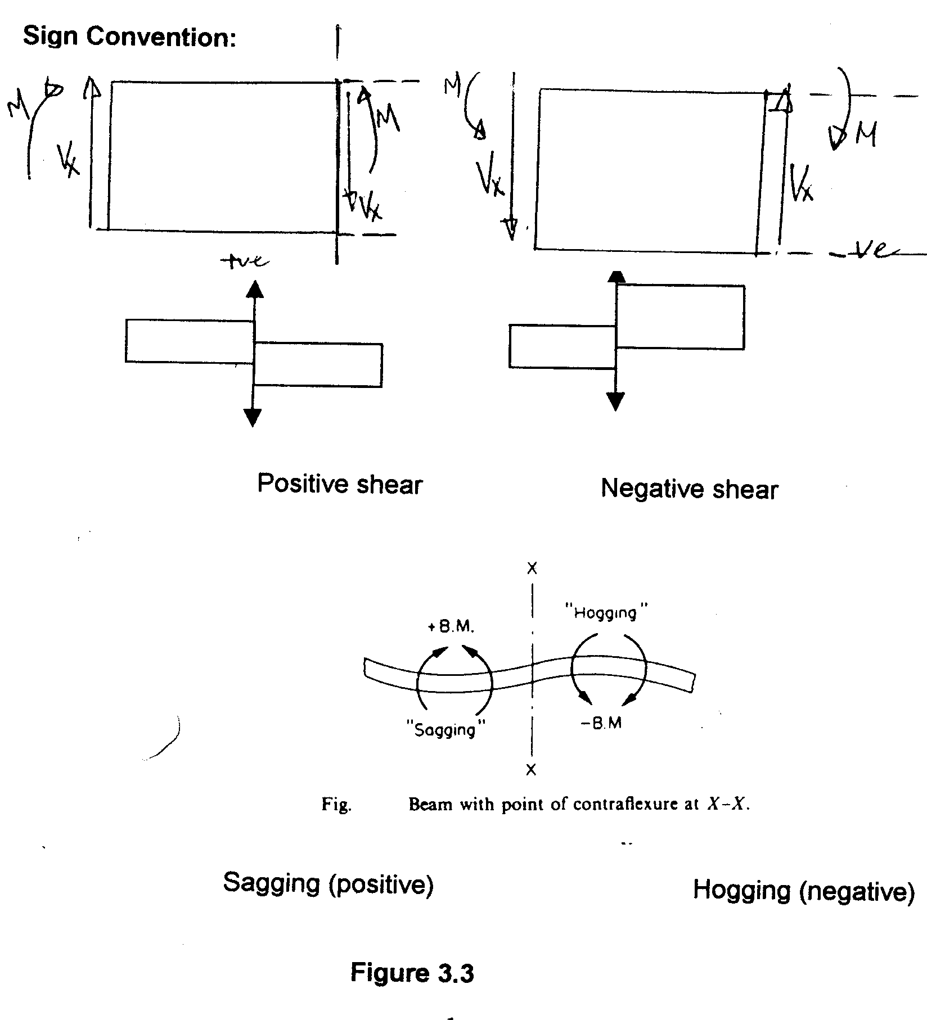
Sign Convention

Slide 14
SIGN CONVENTION CONTD.
Positive directions are denoted by an internal shear force that causes clockwise rotation of the member on which it acts, and an internal moment that causes compression, or pushing on the upper arm of the member.
Loads that are opposite to these are considered negative.

Slide 15
3.1 RELATIONSHIPS BETWEEN LOADS, SHEAR FORCES, AND BENDING MOMENTS
These relationships are quite useful when investigating the shear forces and bending moments throughout the entire length of a beam and they are especially helpful when constructing shear-force and bending moment diagrams in the Section 3.5.

Slide 16
RELATIONSHIPS CONTD.
Consider an element of a beam cut between two cross sections that are dx apart (Figure 3.4a).
The shear forces and bending moments acting on the sides of the element are shown in their positive directions.
The shear forces and bending moments vary along the axis of the beam.

Slide 17
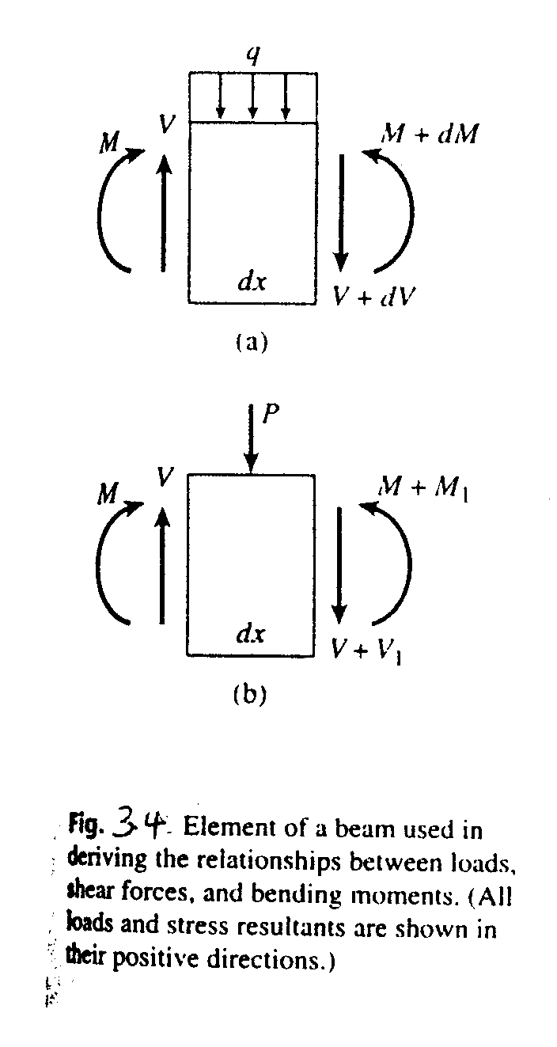
ELEMENTS OF A BEAM

Slide 18
RELATIONSHIPS CONTD.
The values on the right hand face of the element will therefore be different from those on the left hand face. In the case of distributed load, as shown in the figure, the increments in V and M are infinitesimal and so can be denoted as dV and dM respectively.

Slide 19
RELATIONSHIPS CONTD.
The corresponding stress resultants on the right hand face are V + dV and M + dM.
In the case of concentrated load (Figure 3.4b), or a couple (Figure 3.4c), the increments may be finite, and so they are denoted V₁ and M₁.
The corresponding stress resultants on the RHS face are V + V₁ and M + M₁.

Slide 20
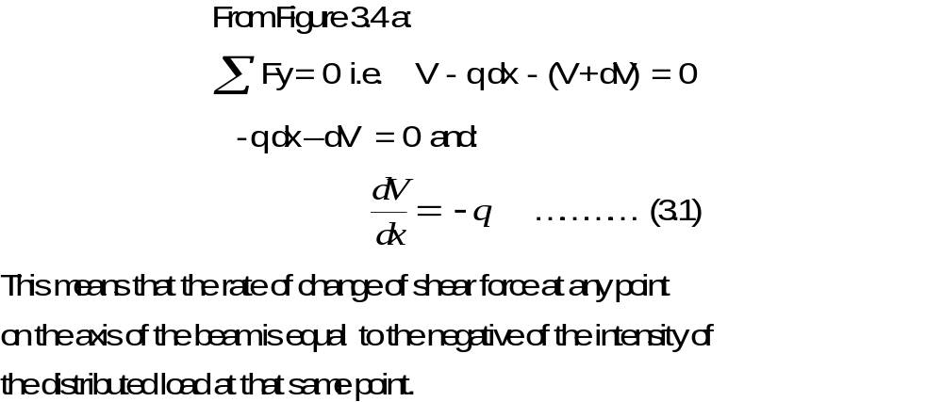
(a) Distributed Loads

Slide 21
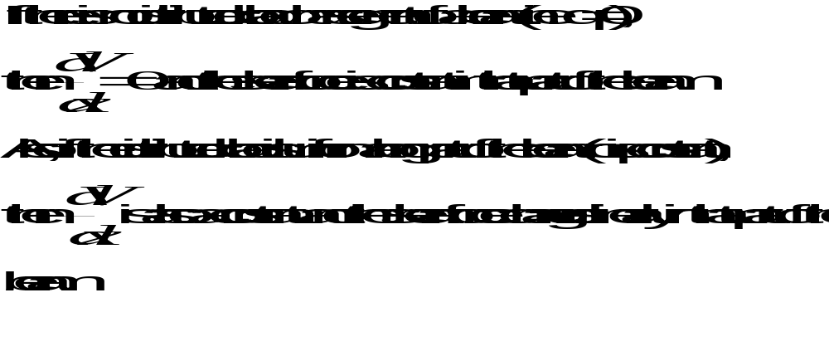
(a) Distributed Loads
Contd.

Slide 22
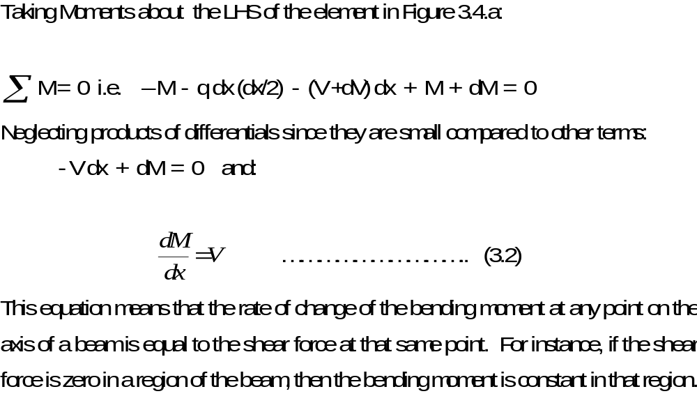
Distributed Loads Contd.

Slide 23
Distributed Loads Contd.
Note that equation 3.2 applies only in regions where distributed loads or no loads act on the beam.
At a point where a concentrated load acts, a sudden change (or discontinuity) in the shear force occurs and the derivative dM/dx is undefined at that point.

Slide 24
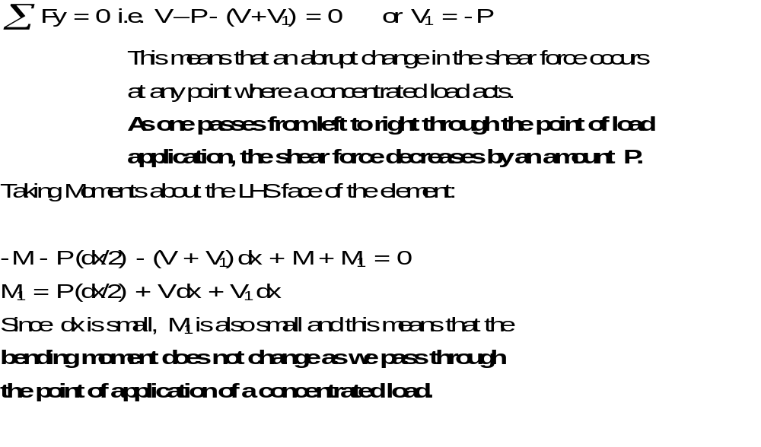
(b) Concentrated Loads (Figure 3.4 b)

Slide 25
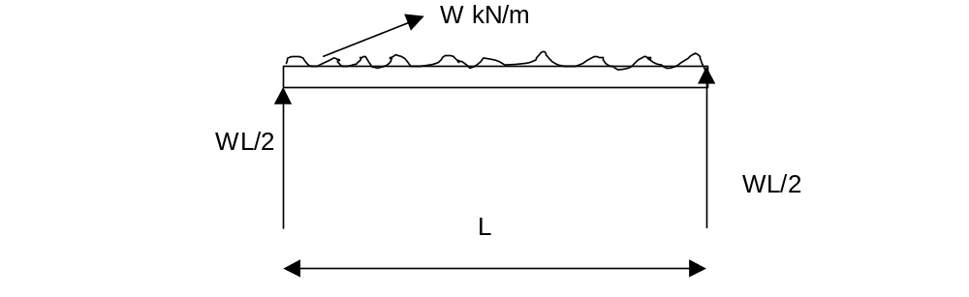
Example
Determine the equation for Bending Moment and Shear force for the beam below:

Slide 26
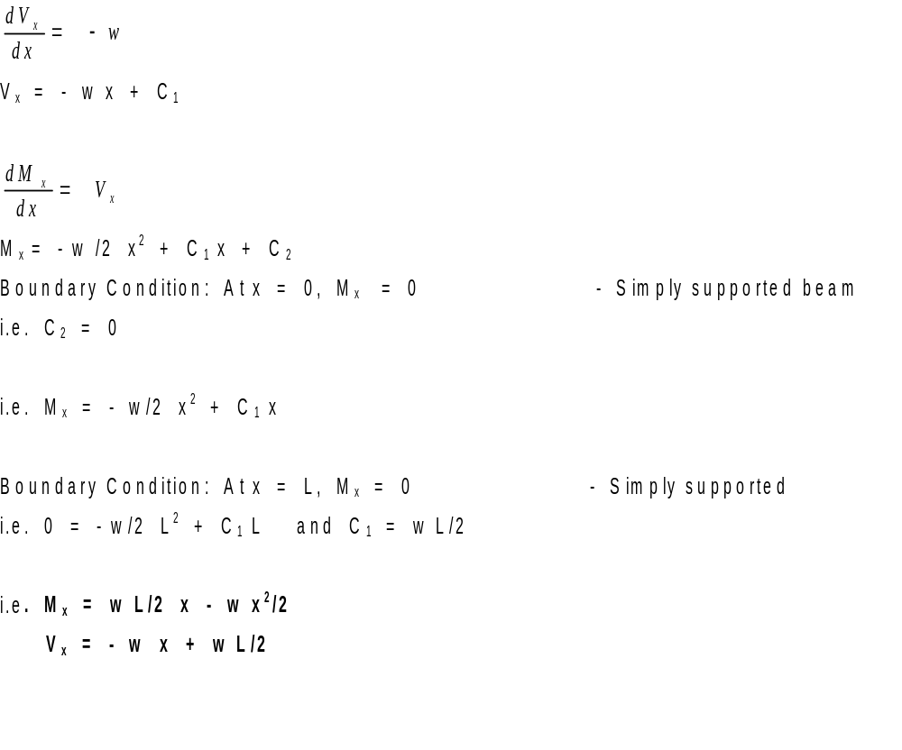
Solution

Slide 27
3.5 SHEAR FORCE AND BENDING MOMENT DIAGRAMS
When designing a beam, there is the need to know how the bending moments vary throughout the length of the beam, particularly the maximum and minimum values of these quantities.

Slide 28
Example
Draw the shear and bending moment diagrams for the beam shown in the Figure.
x
5 kN
x
x
x
2.5 kN
2.5 kN
2 m
2 m

Slide 29
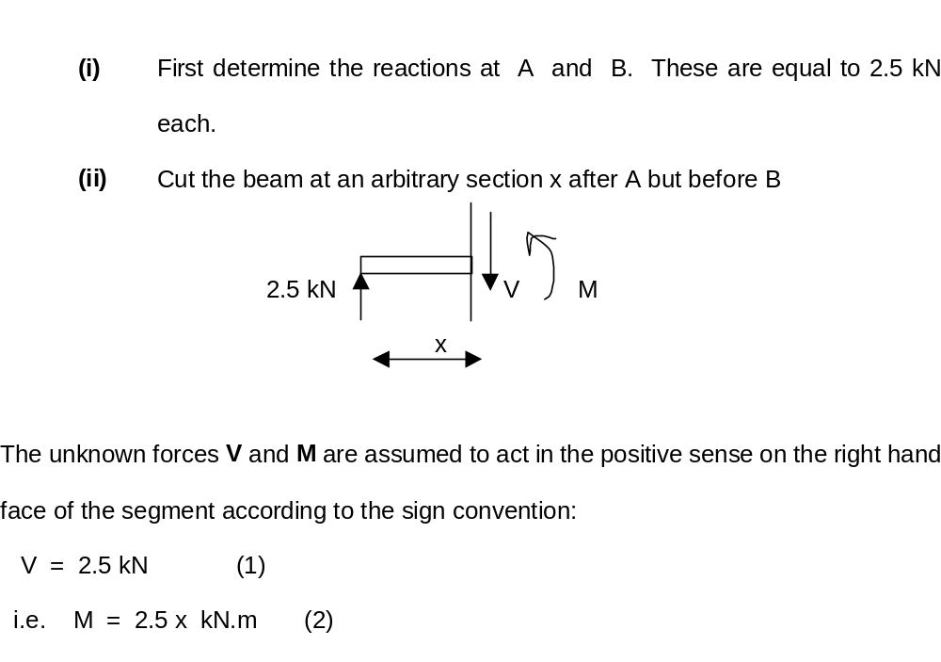
Solution

Slide 30
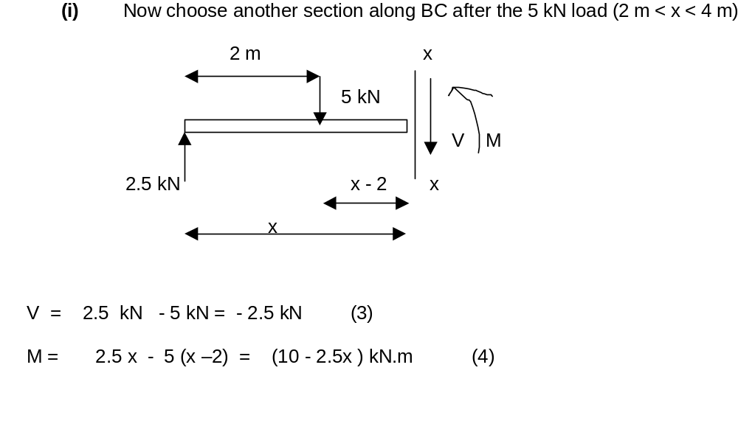
Solution Contd.

Slide 31
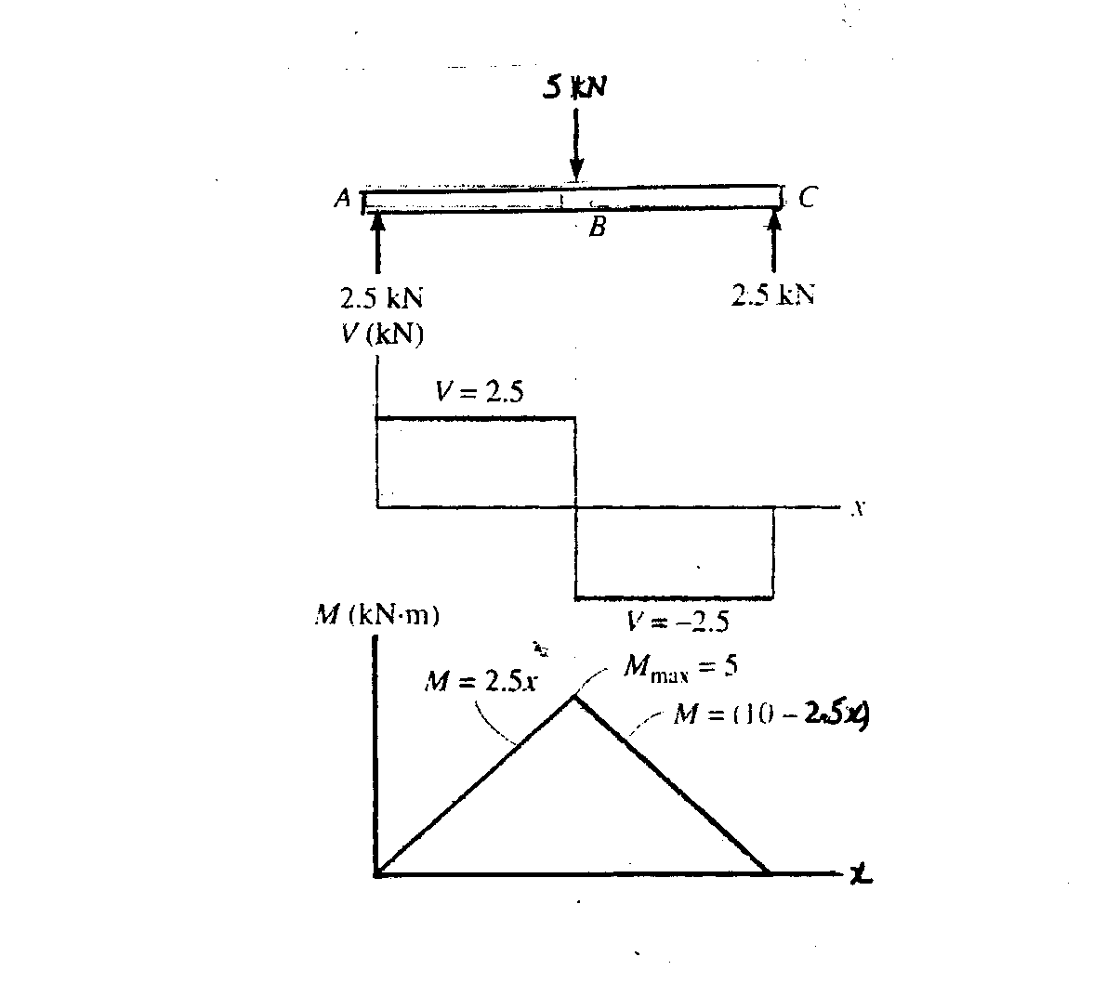
Shear Force and Bending Moment Diagrams

Slide 32
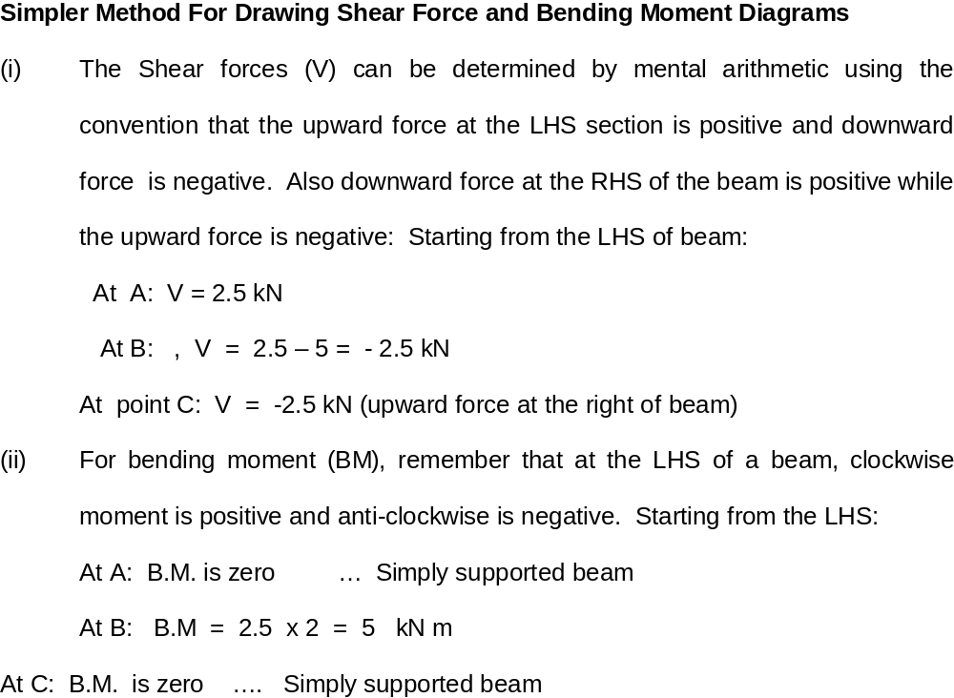
Simpler Method

Slide 33
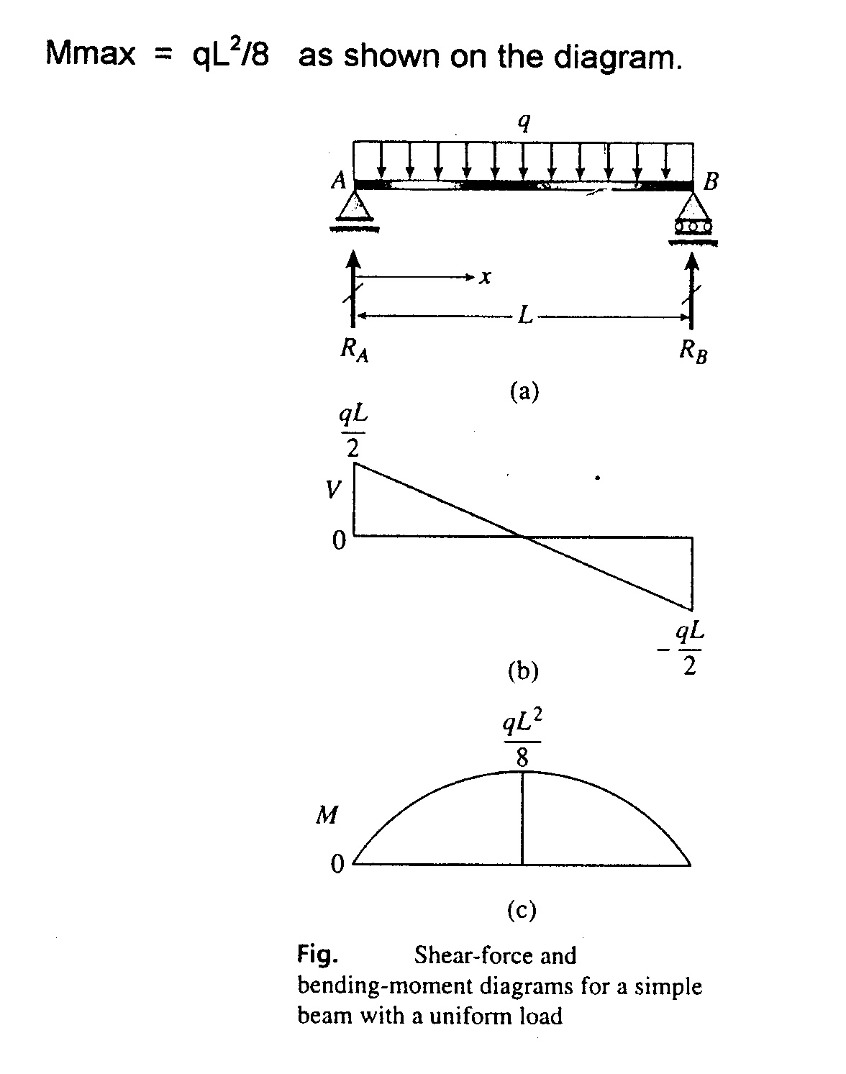
Example
Draw the shear and bending moment diagrams for the beam AB

Slide 34
Solution
Because the beam and its loading are symmetric, R_{A} and R_{B} are q L/2 each. The shear force and bending moment at distance x from the LHS are:
V = R_{A} - q x = q L/2 - q x
M = R_{A} x - q x (x/2) = q L x /2 - q x²/2
These equations, are valid throughout the length of the beam and are plotted as shear force and bending moment diagrams.

Slide 35
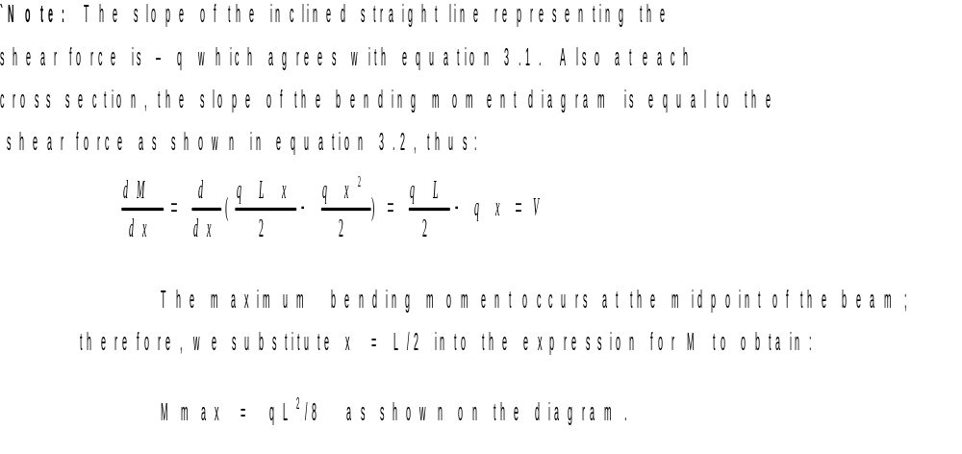
Solution Contd.

Slide 36
Diagrams

Slide 37
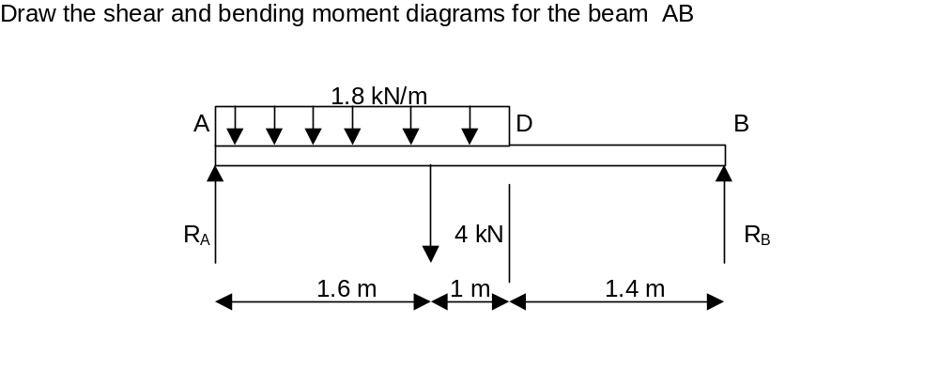
Example

Slide 38
Solution
Find R_{A} and R_{B}
Fy = 0 i.e. R_{A} + R_{B} = (1.8 x 2.6) + 4 kN = 8.68 kN
MB = 0 i.e. - 4 R_{A} + 2.4 x 4 + ( 1.8 x 2.6) x ( 4 - 1.3 ) = 0
4 R_{A} = 9.6 + 12.63 = 22.23;
R_{A} = 5.56 kN
R_{B} = 8.68 - 5.56 = 3.12 kN

Slide 39
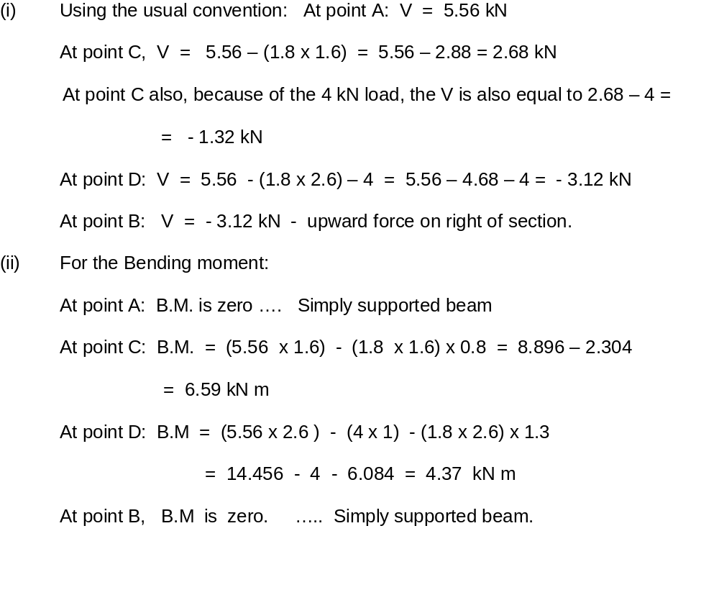
Solution Contd.

Slide 40
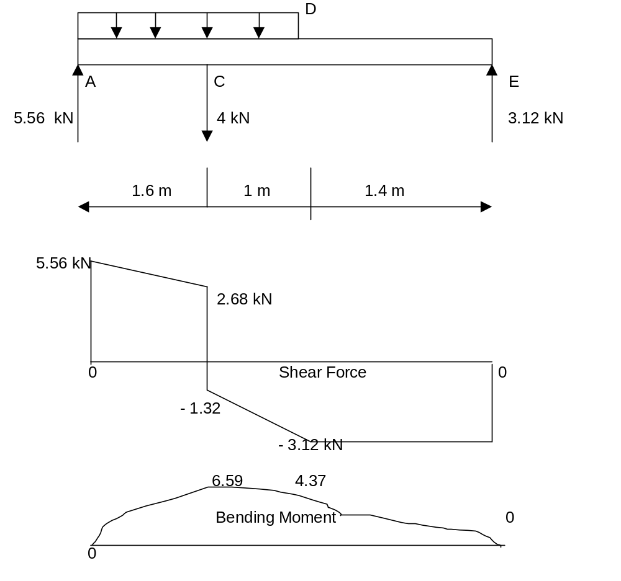
Shear Force & Bending Moment Diagrams

Slide 41
3.1 BENDING STRESSES IN BEAMS (FOR PURE BENDING)
It is important to distinguish between pure bending and non-uniform bending.
Pure bending is the flexure of the beam under a constant bending moment. Therefore, pure bending occurs only in regions of a beam where the shear force is zero because V = dM/dx.
Non-uniform bending is flexure in the presence of shear forces, and bending moment changes along the axis of the beam.

Slide 42
Assumptions in Simple Bending Theory
(i) Beams are initially straight
(ii) The material is homogenous and isotropic i.e. it has a uniform composition and its mechanical properties are the same in all directions
(iii)The stress-strain relationship is linear and elastic
(iv) Young’s Modulus is the same in tension as in compression
(v) Sections are symmetrical about the plane of bending

Slide 43
Assumptions in Simple Bending Theory Contd.
Sections which are plane before bending remain plane after bending.
The last assumption implies that each section rotates during bending about a neutral axis, so that the distribution of strain across the section is linear, with zero strain at the neutral axis.

Slide 44
Assumptions in Simple Bending Contd.
The beam is thus divided into tensile and compressive zones separated by a neutral surface.
The theory gives very accurate results for stresses and deformations for most practical beams provided that deformations are small.

Slide 45
Theory of Simple Bending
Consider an initially straight beam, AB under pure bending.
The beam may be assumed to be composed of an infinite number of longitudinal fibers.
Due to the bending, fibres in the lower part of the beam extend and those in the upper parts are shortened.
Somewhere in-between, there would be a layer of fibre that has undergone no extension or change in length.
This layer is called neutral surface.

Slide 46
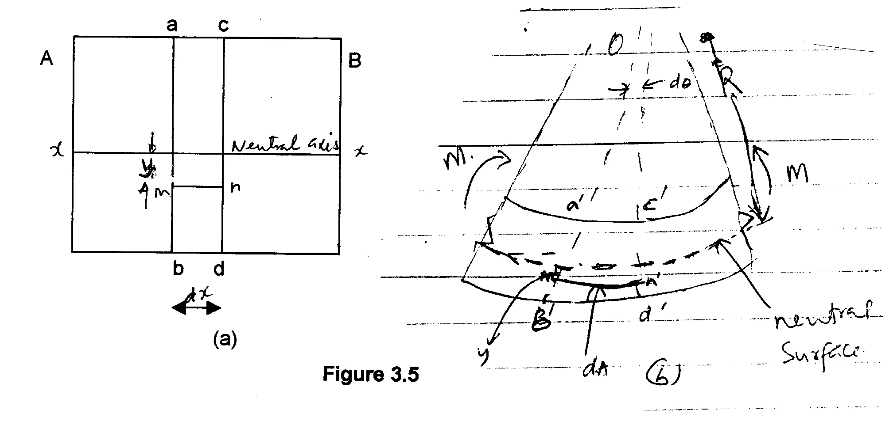
Theory of Bending

Slide 47
Theory of Simple Bending
The line of intersection of the neutral surface with the cross-section is called Neutral Axis of the cross section.

Slide 48
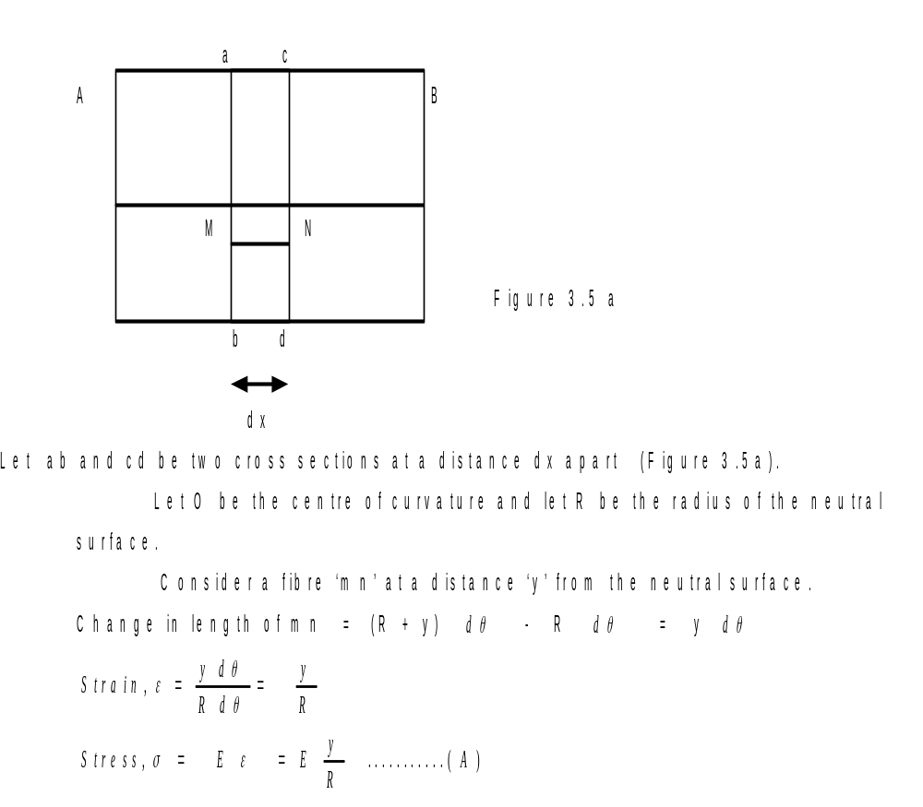
Theory of Simple Bending

Slide 49
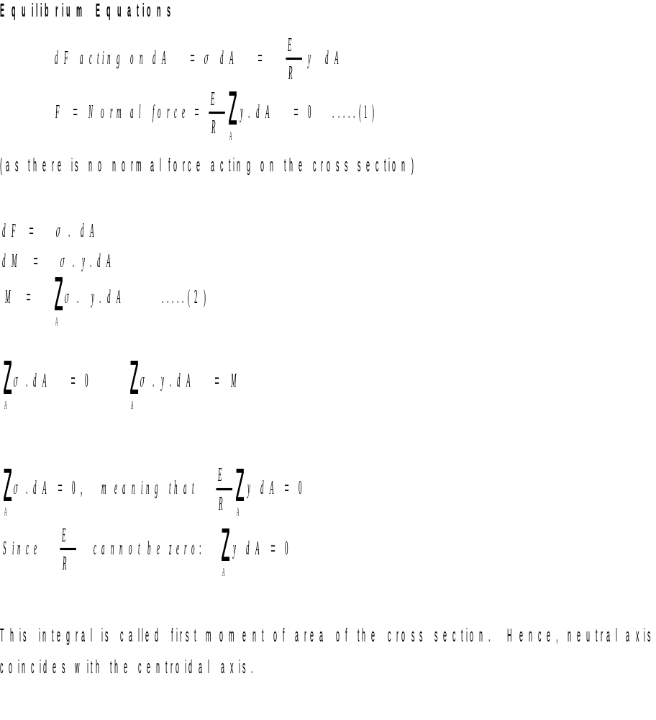
Theory of Simple Bending Contd.

Slide 50
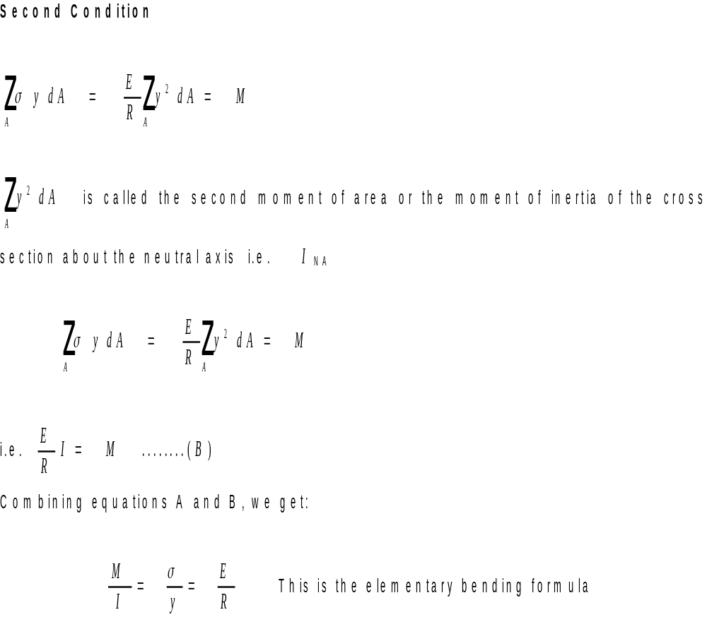
Theory of Simple Bending Contd.

Slide 51
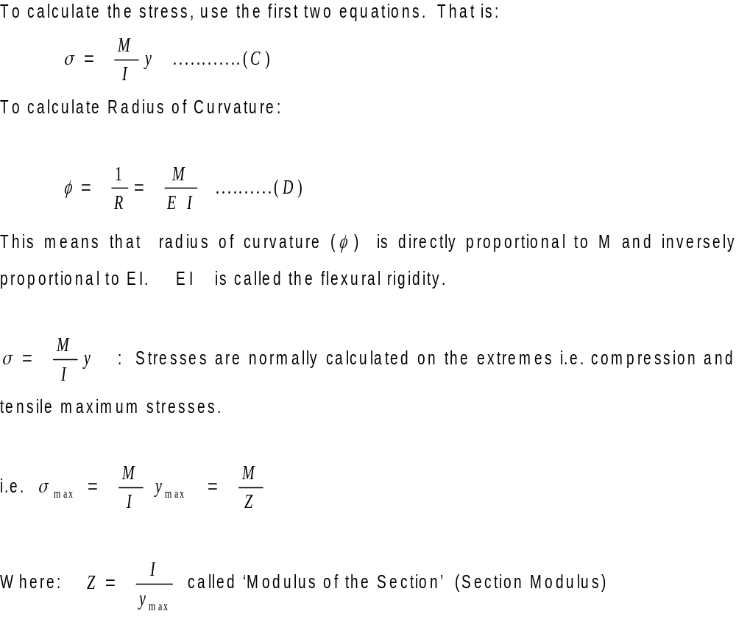
Simple Bending: Calculation of Stress

Slide 52
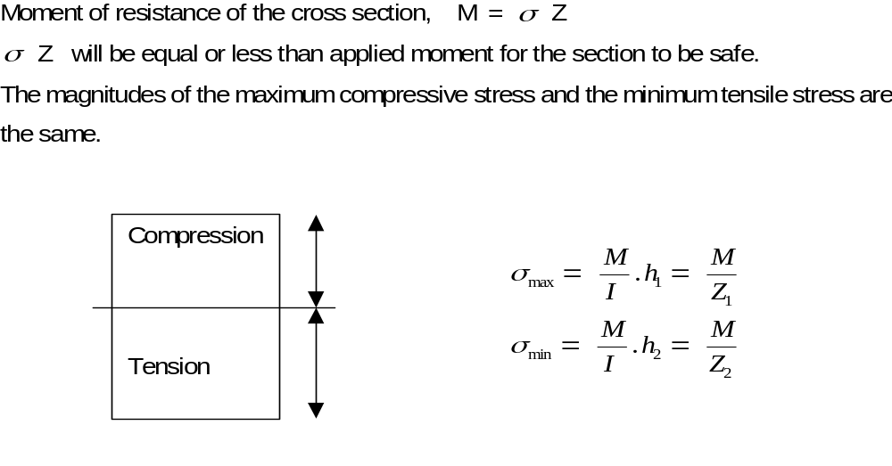
Simple Bending: Compression and Tension Zones

Slide 53
Non-Uniform Bending
Non-Uniform Bending: In the case of non-uniform bending of a beam, where bending moment varies from section to section, there will be shear force at each cross section which will induce shearing stresses.
Also these shearing stresses cause warping (or out-of-plane distortion) of the cross section so that plane cross sections do not remain plane even after bending.

Slide 54
Non-Uniform Bending Contd.
This complicates the problem but it has been found by more detailed analysis that normal stresses calculated from simple bending formula are not greatly altered by the presence of shear stresses.
Thus we may justifiably use the theory of pure bending for calculating normal stresses in beams subjected to non-uniform bending.

Slide 55
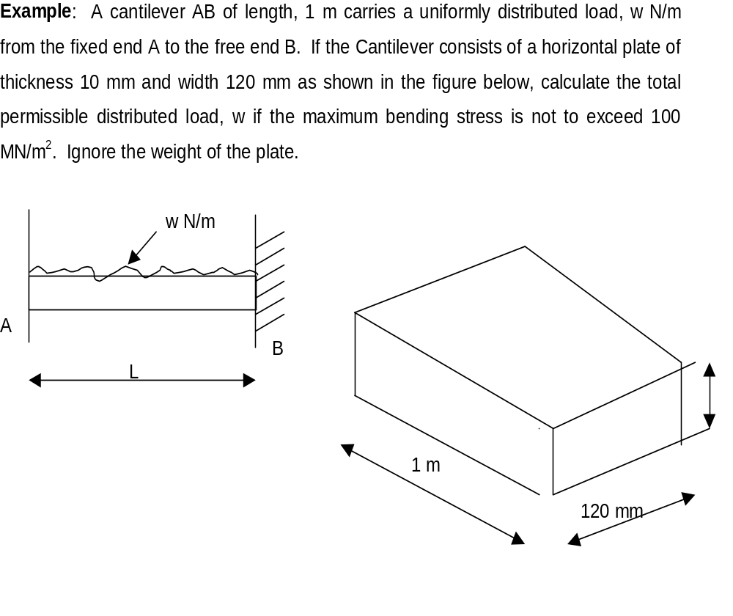
Example

Slide 56
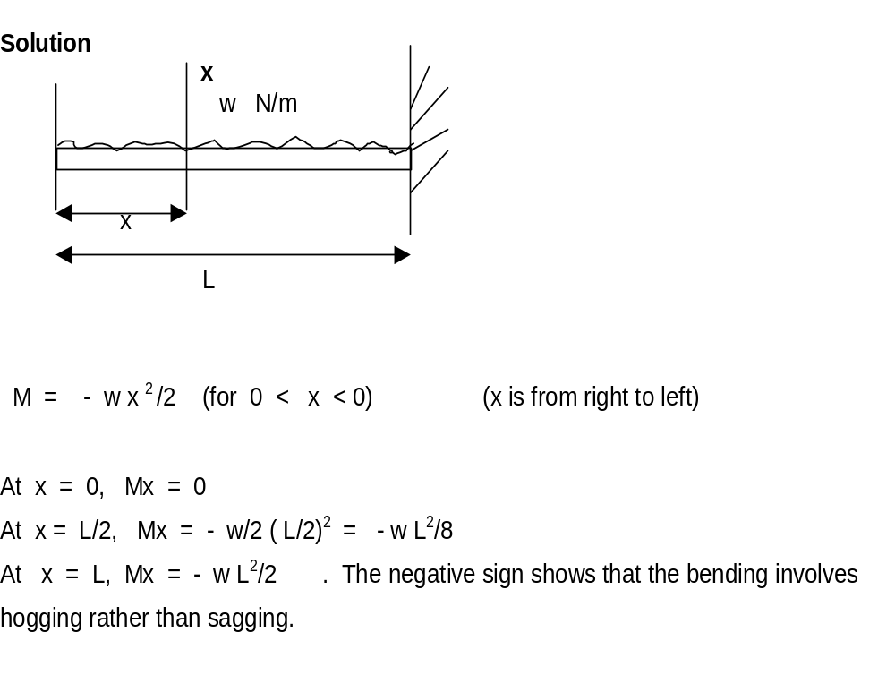
Solution

Slide 57
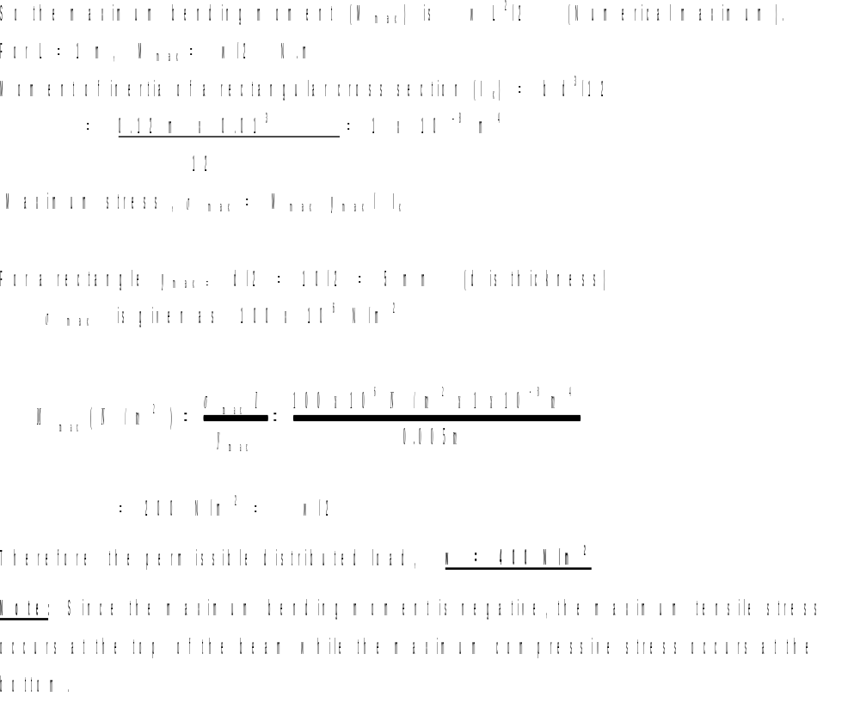
Solution Concluded

Slide 58
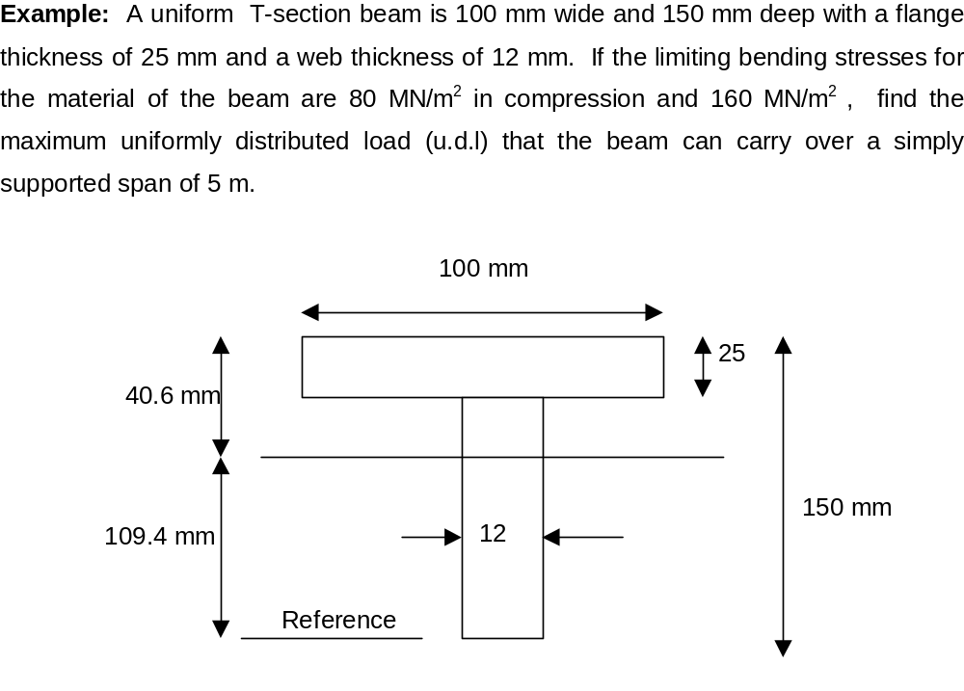
Example

Slide 59
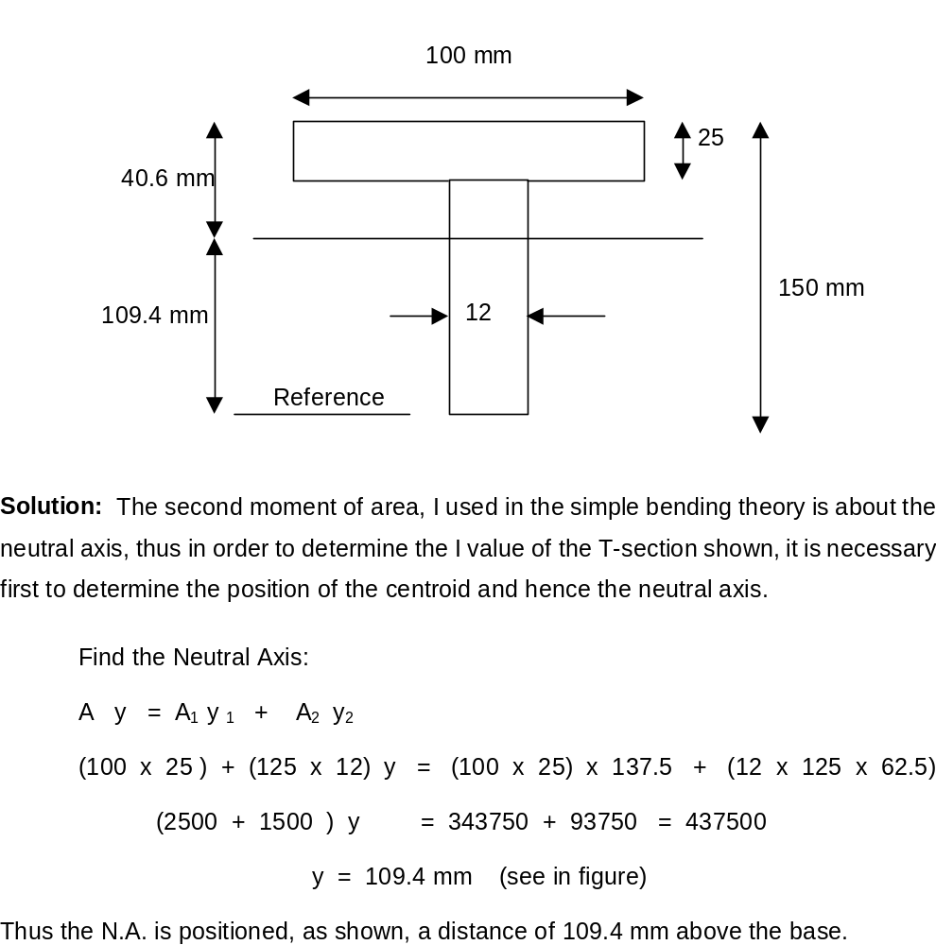
Solution

Slide 60
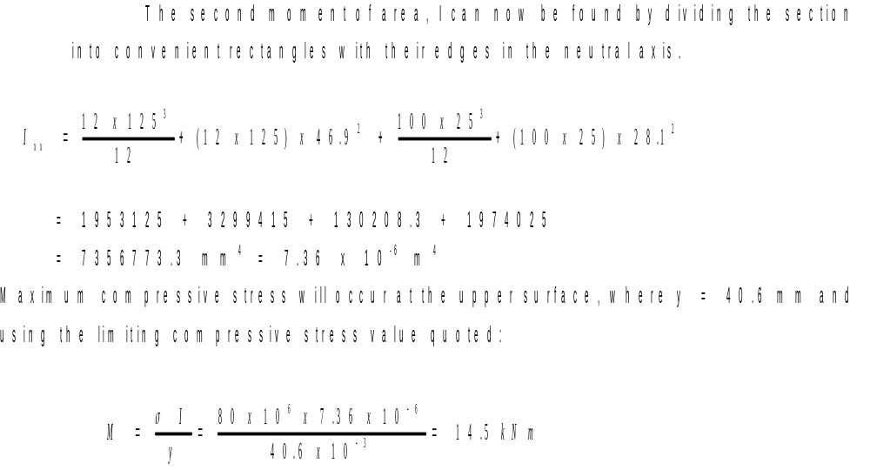
Solution Contd.

Slide 61
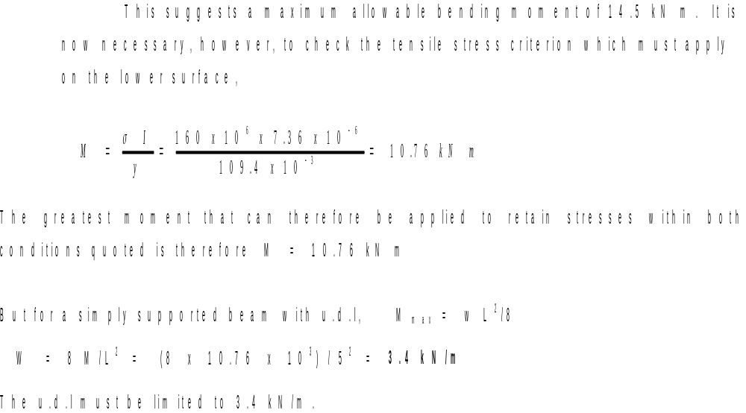
Solution Concluded

Slide 62
4.8. BENDING OF BEAMS OF TWO MATERIALS
A composite beam is one which is constructed from a combination of materials. Since the bending theory only holds good when a constant value of Young’s modulus applies across a section, it cannot be used directly to solve composite-beam problems when two different materials, and therefore different values of E, are present. The method of solution in such as case is to replace one of the materials by an equivalent section of the other.

Slide 63
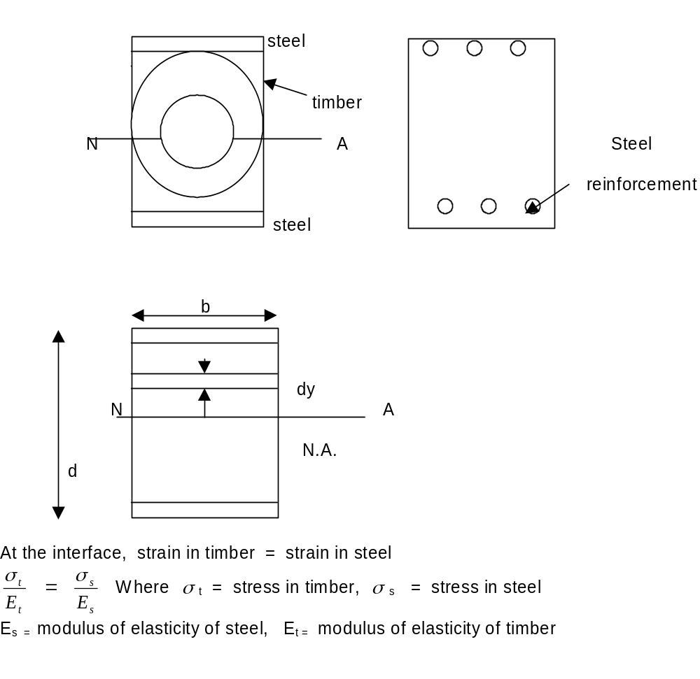
Bending of Beams of Two Materials

Slide 64
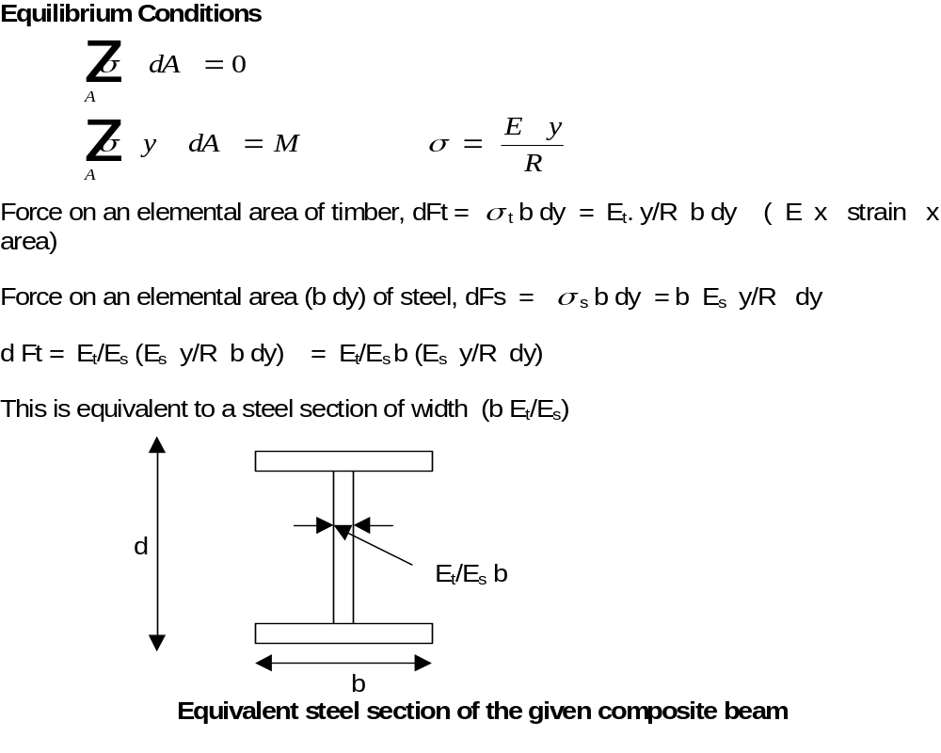
Beams of Two Materials Contd.

Slide 65
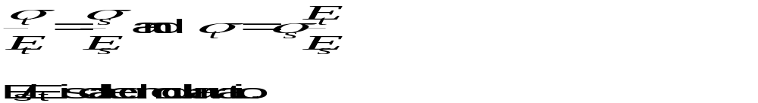
Beams of Two Materials Concluded

Slide 66
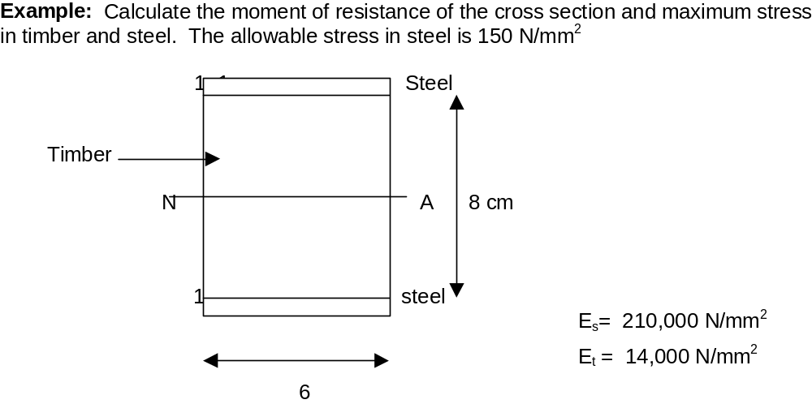
Example

Slide 67
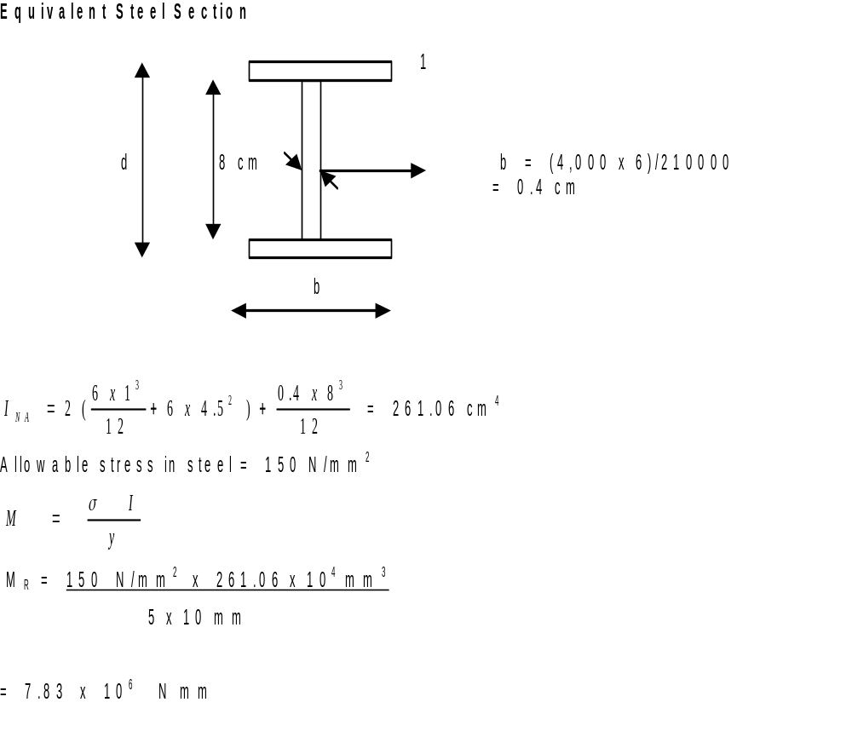
Solution

Slide 68
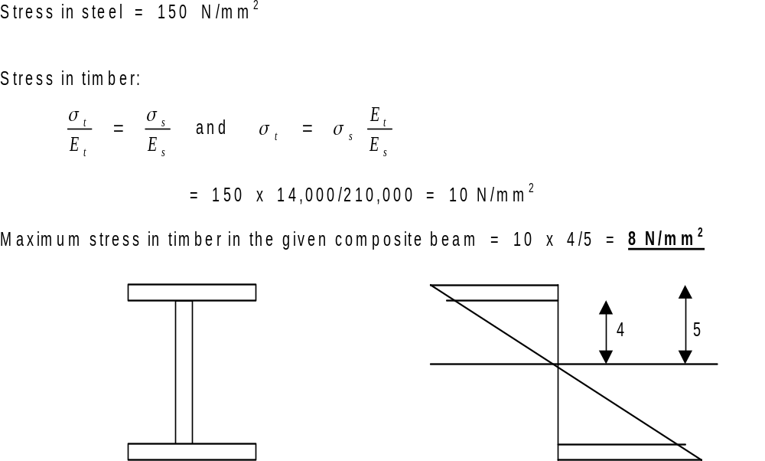
Solution Concluded

